Slide 1
Examining Superfund Sites and Socioeconomics
Project Two
Team Big Data Energy

Slide 2

Team Members
Jack Craft, Project Manager
Carl Mackensen, Subject Matter Expert
Noah Suskin, Analyst

Slide 3
Introduction

Slide 4
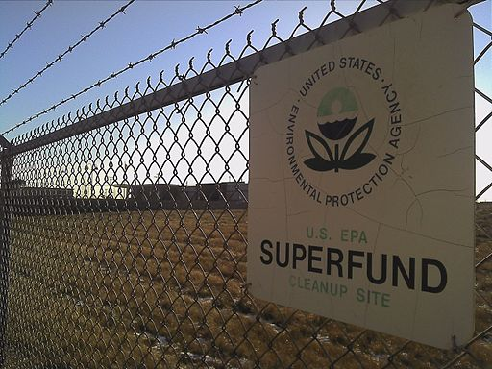
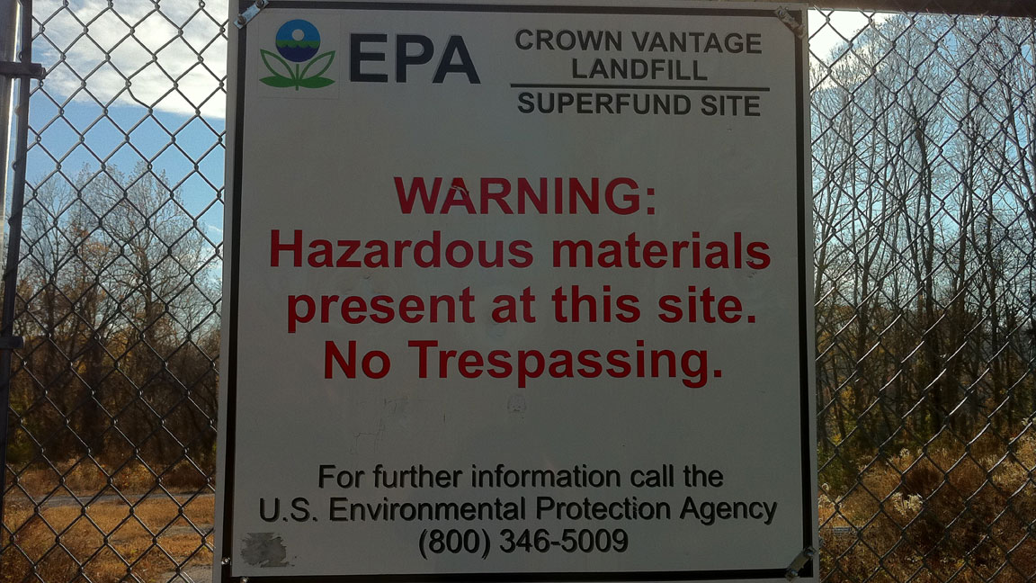
Premise
Superfund sites are among the most polluted sites in the country and are designated by EPA as requiring remediation and clean up.
Most often, these sites are in the vicinity of people belonging to a number of marginalized groups.
This is a core example of an Environmental Justice concern, where your zip code or demographics determine your health outcomes, or environment.

Slide 5

Data Description
The data we found comes from Kaggle.com, specifically at: https://www.kaggle.com/srrobert50/federal-superfunds
The most complete dataset we will be working with is a composite data set from EPA and Census. It is in the form of a JSON
This dataset includes site locations, addresses, and text descriptions of the sites (from EPA) as well as socioeconomic and demographic information such as racial breakdown, income, home ownership, and so on (from Census).
As acquired, the dataset is 845 MB, 310 columns, 200K+ observations. We have trimmed this down to a handful of columns for visualization.

Slide 6

Data Description
This data will then be loaded into a database for access through a python script and a flask server.
Interactive visualizations will be provided via javascript behind a html index page.
The visualizations are provided on a dashboard page. Users can interact with the dashboard to explore the data and the relationships within.

Slide 7

Analysis Dashboard
Our site provides visitors with the means to explore superfund site data. This provides tailored information at their own pace.
The site provides the location of superfund sites visually, which makes them more concrete to the user.
Users can choose a state to see summary data and graphs of socioeconomic relationships of interest.

Slide 8
Our Process

Slide 9















What we did
Step 1: Aquisition
Locate sources and download static data.
Research and review data definitions.
Step 2: Cleaning
Review data and formatting.
Import and clean data.
Store data.
Step 3: Analysis and Transfer
Perform analysis.
Store analysis products.
Reformat for visualization tools.
Step 4: Visualization
Present geographic and demographic data.
Update visualizations with user interactions.

Slide 10
Visualization Dashboard

Slide 11
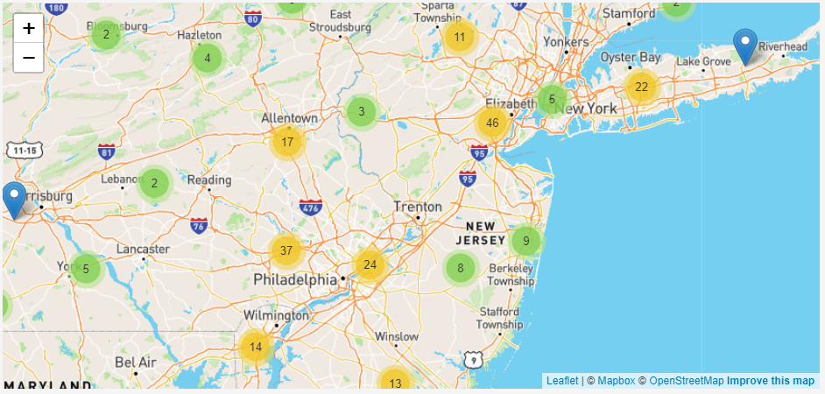
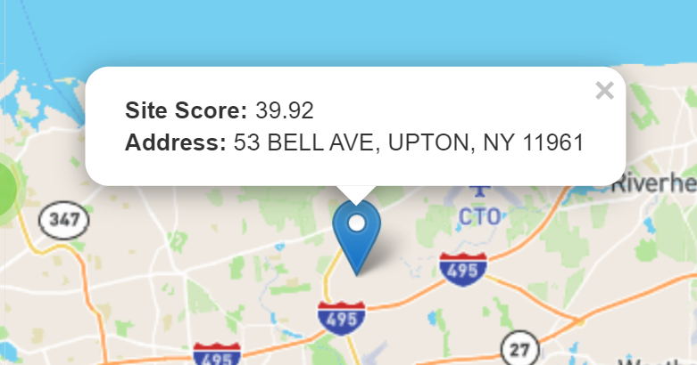
Interactive Map
We begin the visualization of our data using an interactive map. We have a map of the US which shows clusters of superfund sites. Panning and zooming redraws the clusters.
When the user zooms in far enough, individual sites are shown as markers. Clicking on a marker displays the address and EPA score for the site.

Slide 12
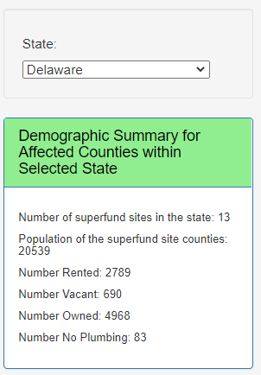
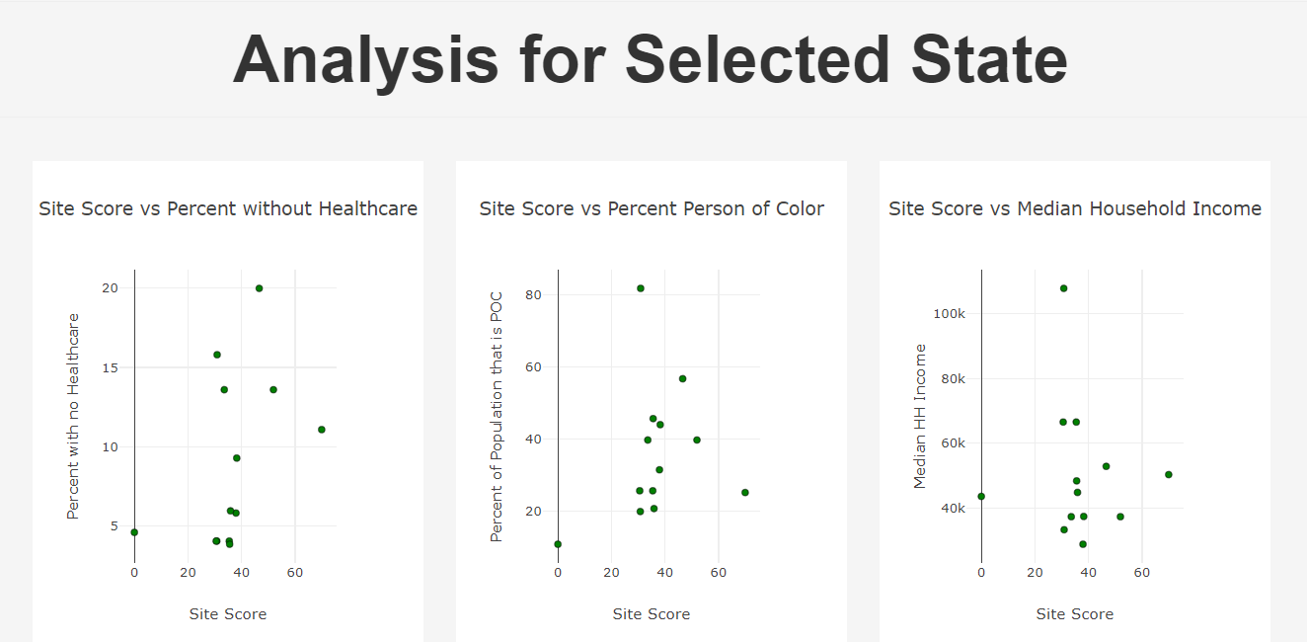
Plots
The user can select an individual state from a dropdown menu.
This drives data to a demographic summary, as well as a series of scatterplots comparing the EPA site score to socioeconomic data for the affected counties.
Specifically, these are Site Score versus Healthcare, Percent Person of Color, and Median Household Income

Slide 13
The Analytics

Slide 14

The Analysis
It is interesting to first view the clusters at the national level. Some states, such as NJ, have a very high number of sites.
Others, like rural areas, tend to have less.
Examining the metadata and plots on a state by state basis provides further information for forming conclusions.
By exploring the interactive dashboard, users can understand their relationship to superfund sites, and the socioeconomic factors at play.

Slide 15
Conclusion

Slide 16
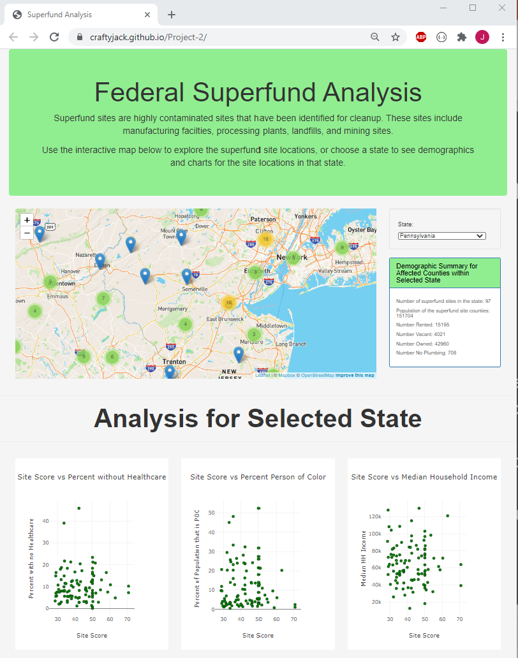
What did we learn?
Cluster mapping displays density patterns effectively and intuitively. It invites the user to drill down to pursue detailed data for a specific marker.
Summary metadata provides a good overview for a filtered selection.
Scatterplots provide a means to intuitively visualize correlations within a filtered selection.

Slide 17
Thank you! Any Questions?

